Slide 1
Reminders
Week 3 In-Class Exercises due in Dropbox by end of class today
Homework #3 due tomorrow at 5:00pm
Exam #1 (Excel) in class on Thursday (Apr. 5)
Solutions for all in-class exercises and homework covered on the exam will be posted on myCourses
We will make every effort to return graded HW#1 & #2 by Wednesday.

Slide 2
Intro to VBA Programming
Week 4, Day 13

Slide 3
Computer Programming
A sequence of instructions to be performed by a computer
What is typed is called “code”
Computers are very useful, BUT
Must be told exactly what to do
Order of instructions is important
Instructions must be in correct syntax
“Computers are dumb; they do exactly what you told them to do, not what you wanted them to do.”

Slide 4
Programming
Steps to develop program code:
Define task to be done
Develop algorithm (This step is important and often skipped/overlooked!)
Code the algorithm
Check/Debug (Debug is often the hardest part)
Refine/Finalize

Slide 5
Programming concepts…
Programs / Macros in VBA:
“Macro” is an older name for a sequence of recorded keystrokes, from before Excel contained a fully-functional programming environment
A program is just a list of directions for the computer to follow
Instructions must be written in a precise manner — called “syntax”

Slide 6
First make sure “Macros” are enabled
MS Office locks out custom programming by default – without warning you about it!
Go to File → Options → Trust Center → Trust Center Settings → Macro Settings
Check either “Disable all macros with notification” (will ask you whether to allow them each time you open a file with macros) or check “Enable all macros”

Slide 7
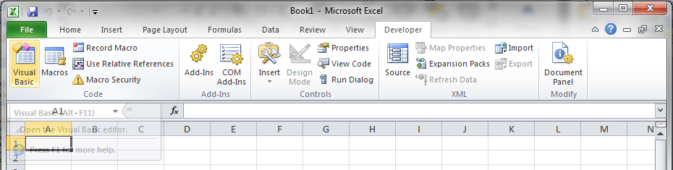
Enable the “Developer” tab and Go to the VBA Editor (VBE)
If the Developer tab is not visible,
Go to File → Options → Customize Ribbon
On the right-hand pane, check “Developer” under “Main Tabs” & click “OK”
Go to Developer → Visual Basic (or press Alt + F11)

Slide 8
The Visual Basic Editor (VBE)
Developer → Visual Basic Editor
Multipanel Environment
Development Area (Program Code, Form Layout)
Project Panel
Properties Panel
VBA Project
Workbook (shown as This workbook in project list)
Worksheets that comprise workbook
Modules that contain VBA code

Slide 9
Modules
Module:
Code sheets specific to your application
Generally accessible from any project source
VBA project normally uses at least one module to store functions and sub procedures
All VBA code for this class must be in a module! (a normal “Module”, not a “Class Module”)

Slide 10
Insert a “Module” for programing…
Go to Developer → Visual Basic (or press Alt + F11)
In VBA, Insert a new Module
All VBA code is written in modules
Do NOT insert a “Class Module”
A workbook can contain multiple modules, just as it can contain multiple worksheets
All worksheets in a workbook have access to functions written in any or all of the modules in that same workbook only

Slide 11
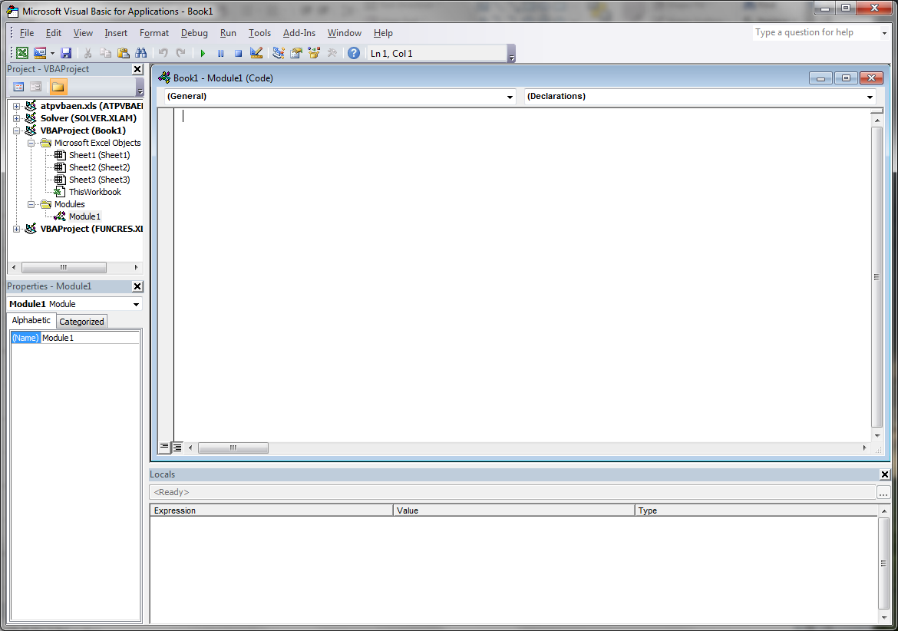
The VBA Environment
The Module panel contains our program code (instructions)
The Project Explorer panel shows which workbook we are working with

Slide 12
Function vs. Sub Procedure
Sub Procedures (also called subroutines) and Functions are pieces of code that perform a set of actions or calculations or a combination of the two
Functions are specialized code that return values
Just like built-in functions
Sub Procedures don’t return values directly
If it performs a calculation, no direct way of finding the results – we have to program all output (and input)

Slide 13
In other words…
Functions (arguments)
Gets input from arguments
Gives output in same manner as built-in function
Sub Procedures (no arguments)
Subroutines have no arguments and must handle their own input/output

Slide 14
Function Syntax
VBA Function syntax
Function MyFunctionName(Argument1, Argument2,…)
<calculations>
MyFunctionName=<final calculation>
End Function
Function name has same rules as variable names
The argument in ( ) is like a place holder
Values assigned in order, variable names have no relationship to named cells in Excel!
Assign the function name (without the arguments) to be equal to the result of the formula you want to evaluate

Slide 15
Sub Procedure Syntax
VBA Sub Procedure Syntax
Sub MySubName() Note: nothing in the parenthesis!
<Inputs>
<Calculations>
<Outputs>
End Sub
Sub procedure name has same rules as variable names
NO arguments in a Sub procedure — for our purposes, parenthesis are just place-holders (like PI function in Excel)
No built-in provision for input & output!

Slide 16

Variables
Variables in VBA:
A variable is a named place-holder for a value,
like a cell reference in a worksheet
or a file folder with the variable name written on the outside
Variable names in VBA must start with a letter and can only contain letters, numbers, and underscore (_), and are case-sensitive. NO spaces or special characters.
A
Variable: (single-value)

Slide 17
Variable Naming Rules
Must begin with a letter
Must contain letters, numbers and underscore character only – no spaces
Can not exceed 40 characters in length
Must not be a “Reserved Word” – these are words used as part of the Excel programming language such as “Do”, “If”, or “Loop”, etc.

Slide 18
Variable Name Examples
Allowed Names
Not Allowed
a
x1x2
X1_Aname_Anyname
sum_of_numbers
1x
x1&x2
sum of numbers
Loop

Slide 19
Data Types
Numeric: integers, floating point (single or double precision), currency
Strings: literal characters – fixed or variable length
Boolean (Logical): only has values of “true” or “false”
Variant: default type unless we tell VBA otherwise – Can accommodate many different types and adjust “on the fly” as needed

Slide 20
Variable Data Type Declaration
Implicit
Let VBA decide which type – assigns Variant to all and adjusts based upon assignment of value
This is the default unless you tell it to do something else
Explicit
We specify the data type for all variables
Use the “Dim” statement to do so
We will use explicit variable-naming beginning next week

Slide 21
Help on Data Types
In VBA Help, look up “Data Type Summary”
This will list all of the different types and how much memory each type takes.
Choose the type that best fits your input or desired output

Slide 22
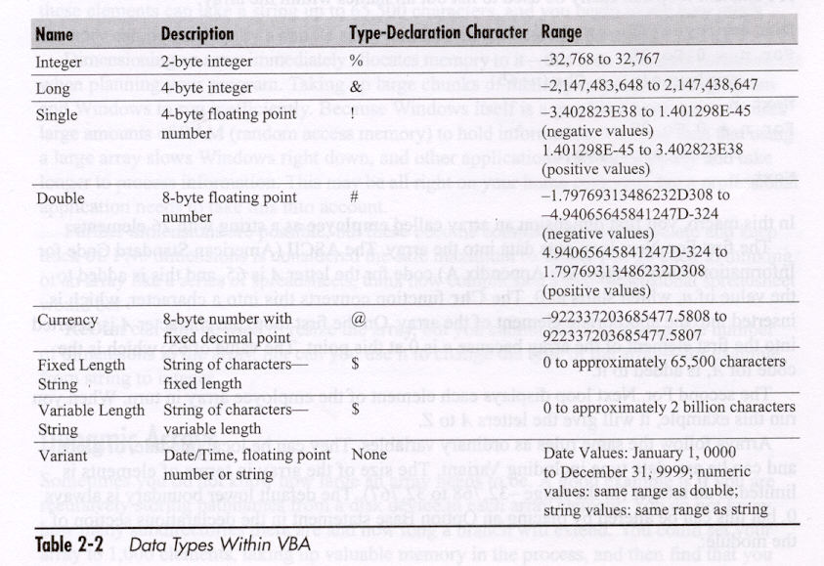
Help on Data Types
See Table 2-2 on page 19 of text

Slide 23
Math syntax in VBA
VBA uses the same symbols and follows the same order of operations as Excel:
functions,
exponents (^),
multiplication/division (*, /),
addition/subtraction (+, -),
from inner-most to outer-most level of parenthesis
Math functions in VBA follow the same syntax as Excel:
functionname(argument)

Slide 24
Math syntax in VBA
The ‘equals sign’ (=) in VBA can be used in two ways
To assign the result of a formula to a variable
As a test to see if two variables have the same value (used later)
Example of assignment: y = x * sin(x) Read this line of code as: “Set the value of the variable named ‘y’ to be equal to the result of the value of the variable named ‘x’ times the sine of the value of ‘x’.”

Slide 25
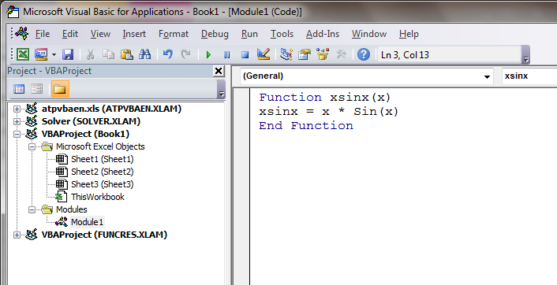
In-Class Exercise #1
Open a new MACRO-ENABLED workbook
Create a function to calculate the value of x ⋅ sin x
This is the function argument
This is the name of the function
Function name assigned to result of formula

Slide 26
Insert the function into worksheet…
In a cell, type
=xsinx(A1) (or whatever your cell ref. is)
Or, Formulas → Insert Function → User Defined
This function can be dragged down/across just like any formula or built-in function
As it is dragged, the cell reference inside of ( ) will increment the row or column the same as any other function

Slide 27
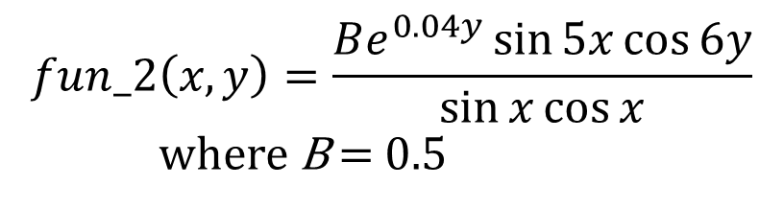
In-class Exercise #2
Write a VBA function to evaluate fun_2(x,y) for values of x and y ranging from 0 to 1 with increments of 0.1
Verify your solution with Excel functions
Hint: Don’t try to write the entire formula in one line of code. Create & use some “temporary” variables inside your function to simplify your code.
$$fun_2\left(x,y\right)=\frac{Be^{0.04y}\sin{5x}\cos{6y}}{\sin{x}\cos{x}}$$
where B = 0.5

